Slide 1
Natural Language Processing on the Federal Reserve System
Group members:
Stephen Kusrianto
Stanley Wong
Sam Lim
Jiang Jin

Slide 2
AGENDA
Introduction
Literature Review
Topic Modelling
Sentiment Analysis
Conclusion

Slide 3
Introduction
By Jiang Jin

Slide 4
Literature review
Blei, D. M., Ng, A. Y., & Jordan, M. I. (2003). Latent dirichlet allocation - Journal of Machine Learning Research. Journal of Machine Learning Research. Retrieved December 14, 2022, from https://jmlr.org/papers/volume3/blei03a/blei03a.pdf
Blinder, A. S., Ehrmann, M., Fratzscher, M., de Haan, J., & Jansen, D.-J. (2008). Central Bank Communication and Monetary Policy: A Survey of Theory and Evidence. Journal of Economic Literature, 46(4), 910–945. http://www.jstor.org/stable/27647085
Hubert, P., & Labondance, F. (2021). The signaling effects of Central Bank tone. European Economic Review, 133, 103684. https://doi.org/10.1016/j.euroecorev.2021.103684
4.Mimno, D., Wallach, H. M., Talley, E., Leenders, M., &amp; McCallum, A. (2011). Optimizing semantic coherence in topic models - Cornell University. Cornell Bowers Information Science. Retrieved December 14, 2022, from https://mimno.infosci.cornell.edu/papers/mimno-semantic-emnlp.pdf
5.Mikolov, T., Chen, K., Corrado, G., & Dean, J. (2013, September 7). Efficient estimation of word representations in vector space. arXiv.org. Retrieved December 14, 2022, from https://arxiv.org/abs/1301.3781
6.Hyndman, R. J. (2014). Measuring forecast accuracy - Rob J. Hyndman. Rob J Hyndman. Retrieved December 15, 2022, from https://robjhyndman.com/papers/forecast-accuracy.pdf
7.Řehůřek, R., & Sojka, P. (2010) Software Framework for Topic Modelling with Large Corpora. Proceedings of the LREC 2010 Workshop on New Challenges for NLP Frameworks. (pp. 45-50). ELRA. http://is.muni.cz/publication/884893/en
8.Dalio, R. (2011, August). Engineering targeted returns and risks . Retrieved December 14, 2022, from https://bridgewater.brightspotcdn.com/fa/e3/d09e72bd401a8414c5c0bdaf88bb/bridgewater-associates-engineering-targeted-returns-and-risks-aug-2011.pdf
9. Selenium. (n.d.). The Selenium Browser Automation Project. https://www.selenium.dev/documentation/webdriver/
PYPI. (n.d.). Fedtools 0.0.7. Fedtools · PyPI

Slide 5
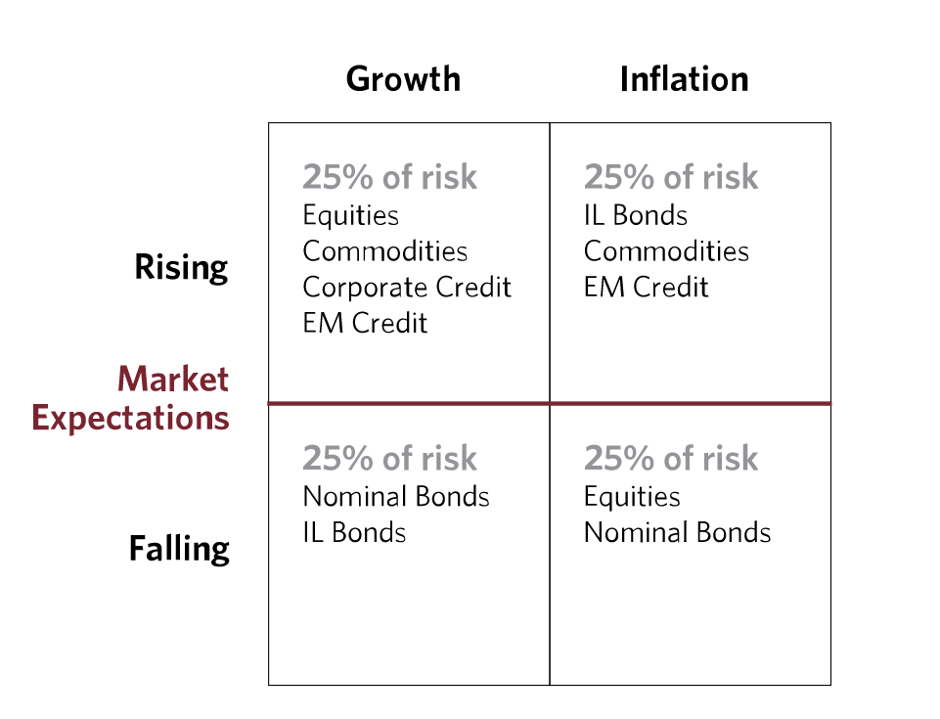

All weather portfolio
Source: The All Weather Story. (2012, Jan). Bridgewater Associates. https://www.bridgewater.com/research-and-insights/the-all-weather-story
5

Slide 6
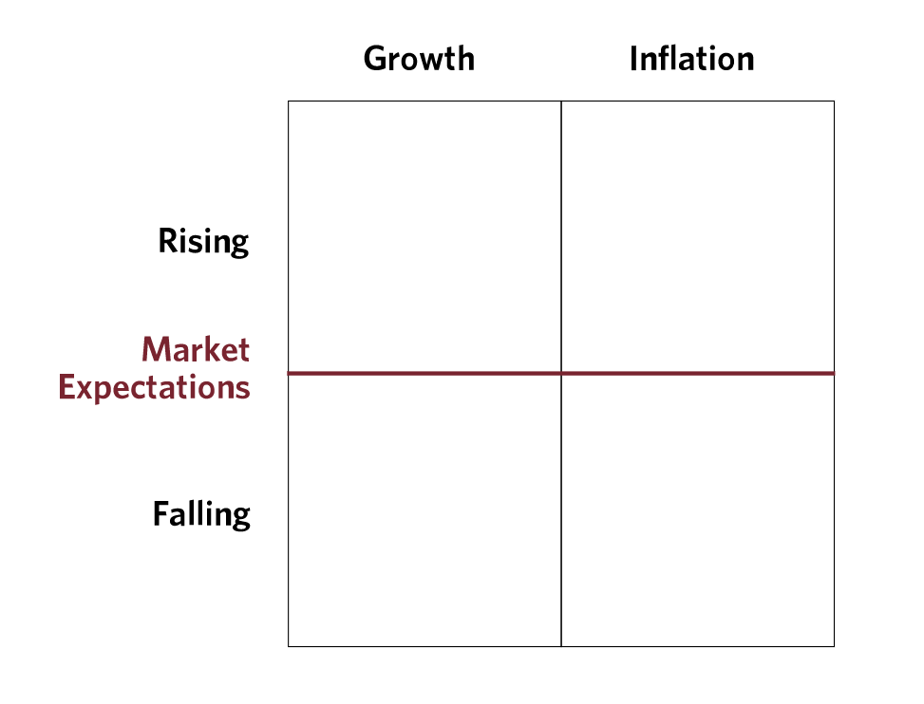

Weather forecast portfolio
​ Asset Class ​ | ​ ETF ​
​ Equity ​ | ​ SPY ​
​ Commodities ​ | ​ DBC ​
​ Corporate Credit ​ | ​ LQD ​
​ Emerging Market(EM) credit ​ | ​ EMB ​
​ Nominal bonds ​ | ​ BND ​
​ Inflation Linked (IL) bonds ​ | ​ TIP ​

Slide 7
Topic modelling with Word2vec & Latent Dirichlet allocation
By Stanley

Slide 8
Text Preprocessing
process flow
Data Sourcing
Text Cleaning [regular expression]
Lemmatization
Filter stopwords
Generate corpus
Word embedding with Word2Vec
Topic modelling with LDA
Topic modelling
Notes:
Data sourcing: Selenium webdriver = Fed speech, minutes, statement, beige book
Text Cleaning: Regular expression [punctuations, lowercased letters, remove any line breaks characters from scrapping]
Lemmatization: Python package from NLTK Lemmatization [match different form of words to map it to its base word]
Stopwords: Filter out most common words that is not important

Slide 9
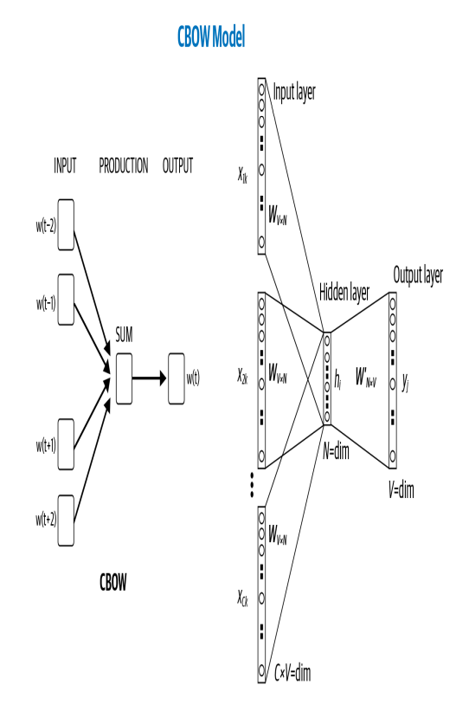
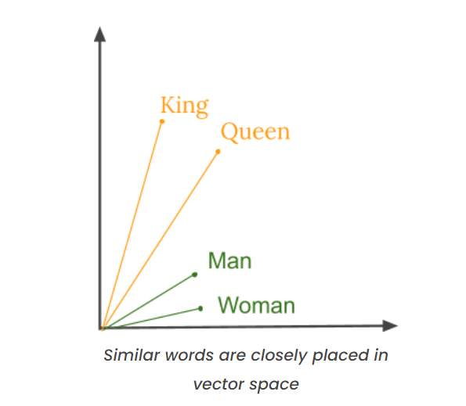
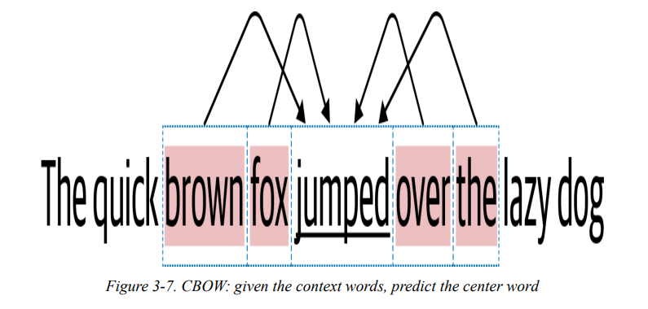
word2vec
methodologies
Cosine Similarity
Source: [1] Vajjala, S., Majumder, B., Gupta, A., & Surana, H. (2020). Chapter 1. NLP: A Primer. Practical natural language processing: a comprehensive guide to building real-world NLP systems (1st Eds). (pp. 9). O'Reilly Media, Inc.
[2] Great Learning Team. (2020, July 20). What is Word Embedding | Word2Vec | GloVe. Great Learning. What is Word Embedding | Word2Vec | GloVe (mygreatlearning.com)

Slide 10
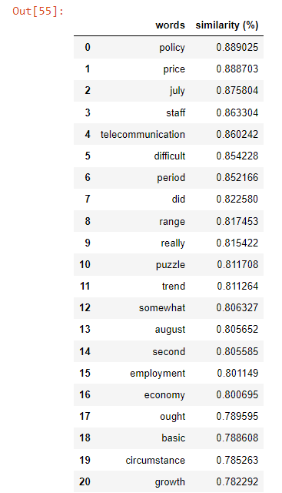
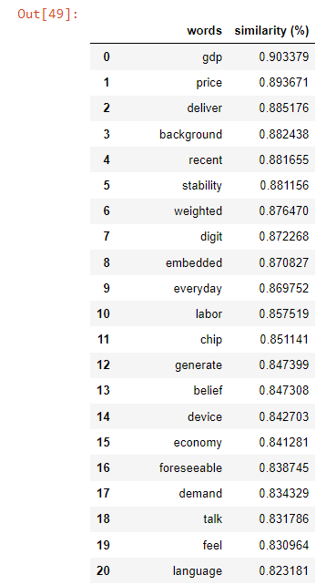
word2vec
Label our dtm based on cosine similarity results
inflation
growth

Slide 11
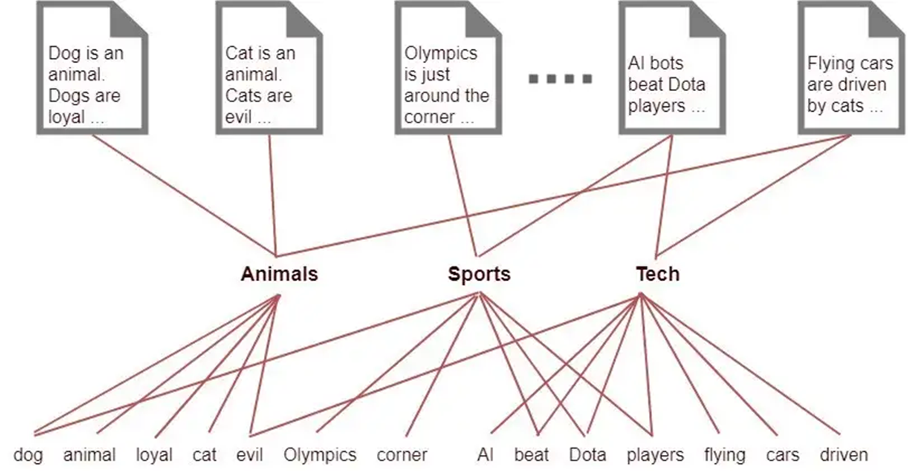
LDA & elda
Latent Dirichlet allocation & ensemble Latent Dirichlet allocation
LDA
ELDA
Solve the issue of topics reproducibility from LDA model.
Addresses the issue by training multiple topic models and discard topics that do not occur across ensembles. (More reliable)
Source: [1] "Light on Math Machine Learning: Intuitive Guide to Latent Dirichlet Allocation", Ganegedara T., (2018, Aug 23). In Medium. https://towardsdatascience.com/light-on-math-machine-learning-intuitive-guide-to-latent-dirichlet-allocation-437c81220158
[2] Ensemble Latent Dirichlet Allocation. (n.d.). GENSIM
Notes:
LDA: Unsupervised Model for Topic Modelling
Draw semantic meaning from the document text corpus
based on probability distribution of the words and documents linking them to form relevant topics that best describe the dataset
We use a Semi-supervised approach using Word2Vec similarity words to guide LDA towards
Topic of "growth" and "inflation"

Slide 12
Word2Vec
Limitations of word2vec & lda
Future project idea
top2Vec
Requires a large corpus with quality inputs to generate meaningful results.
Hubness problem, common word vectors share closer distance that may generate noise to cause bias to the evaluation.
Can't handle out-of-vocabulary (OOV) words and morphologically similar words
LDA
Doesn't require manual preprocessing. Preprocessing has been in-built into function
Combines document and word embedding vectors to search for semantic meaning to generate topics.
Reduced high dimensionality sparsity issue using UMAP.
Doesn’t consider sentence structuring and language flow to derive semantic meaning
Performs poorly if the dataset is small or length of document is too short
Computationally intensive training on sparse vector representation
Source: Angelov, D. (2020). Top2Vec: Distributed Representations of Topics. ArXiv, abs/2008.09470. https://arxiv.org/abs/2008.09470v1
Naushan, H. (2020, Dec 3). Topic Modeling with Latent Dirichlet Allocation. In Medium. https://towardsdatascience.com/topic-modeling-with-latent-dirichlet-allocation-e7ff75290f8
Notes:
Sparse vector representation computationally intensive; requires large memory and time to train
Top2Vec calculate the centroid of document vectors in original dimension to find the topic vector.

Slide 13
Findings, Insights, and Topic model Selection
By Stephen

Slide 14
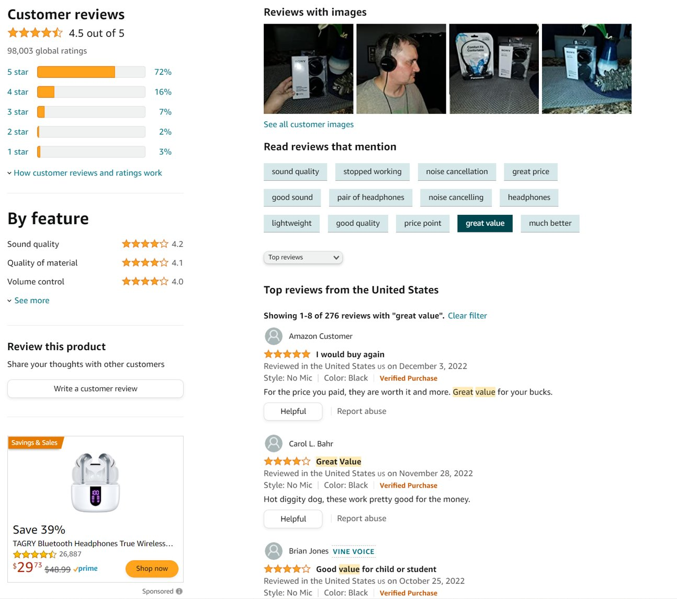

Latent Diri...what?

Slide 15
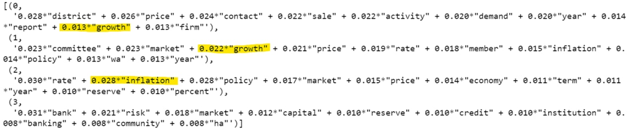
Topic Models

Slide 16
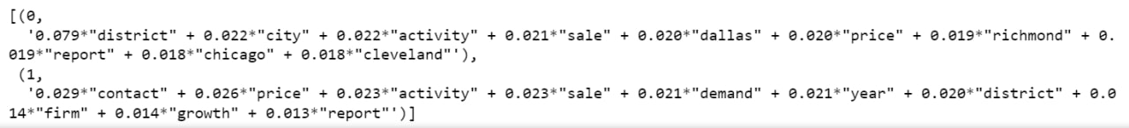
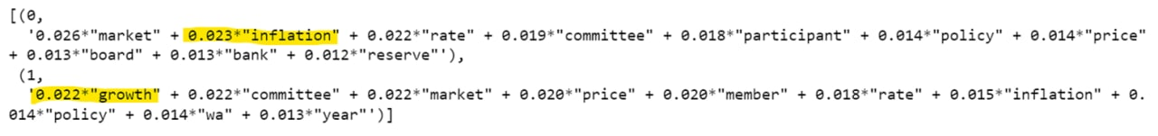
Insights
1. Topic Models from Beige Books do not provide meaningful interpretations toward economic regimes:
2. On the flip side, Fed Minutes provide highly relevant Topic Models for our use case:
We can map these topic models back to every transcripts and allocate assets based on regulator views.

Slide 17
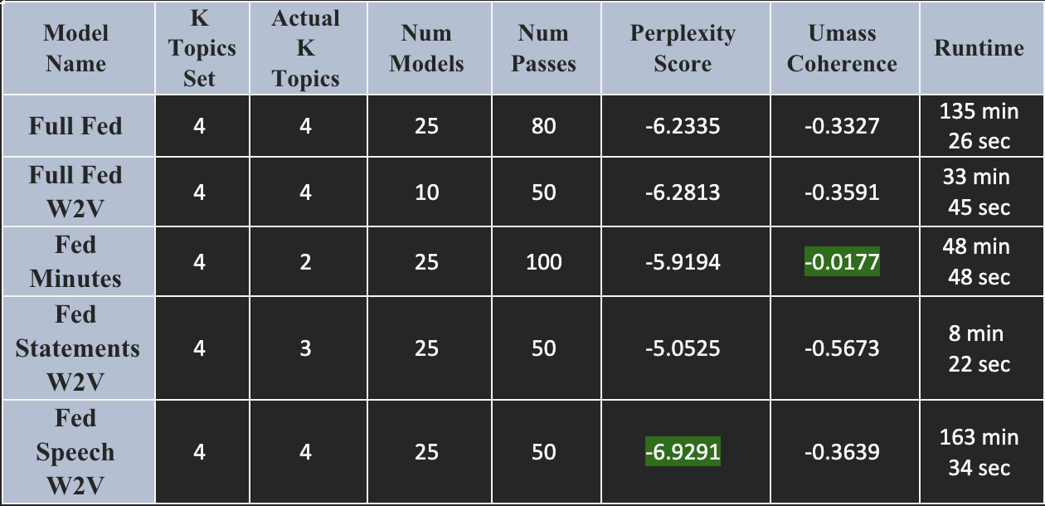
Shortlisted Ensemble LDA ModelS
Source: Blei, D. M., Ng, A. Y., & Jordan, M. I. (2003). Latent dirichlet allocation - Journal of Machine Learning Research. Journal of Machine Learning Research. Retrieved December 14, 2022, from https://jmlr.org/papers/volume3/blei03a/blei03a.pdf Mimno, D., Wallach, H. M., Talley, E., Leenders, M., &amp; McCallum, A. (2011). Optimizing semantic coherence in topic models - Cornell University. Cornell Bowers Information Science. Retrieved December 14, 2022, from https://mimno.infosci.cornell.edu/papers/mimno-semantic-emnlp.pdf

Slide 18
Model Limitations & Future WORK
LDA, or rather topic modelling techniques as a classifier is a relatively weak solution in general because they are a generative model, whereas classification is a discriminative problem. We used Word2Vec preprocessing to serve as a semi-supervised discriminatory criterion.
Accuracy of signal inference on regulator views are highly sensitive to data source, its preprocessing and the interpreter's ability to capture such insights.
Consider other NLP techniques (I.e., BERTopic for larger corpus or NMF for smaller ones)
Consider topic modelling as an input feature for supervised machine learning models, leveraging other Macroeconomic indicators to achieve greater prediction accuracy
Source: Sbalchiero, S., & Eder, M. (2020). Topic modeling, long texts and the best number of topics. Some Problems and solutions. Quality & Quantity, 54, 1095-1108.

Slide 19
Strategy Performance
By Jiang Jin

Slide 20
Backtesting Results
Model Name | CAGR | Annualized Sharpe | Annualized Vol | Maximum Drawdown Period | Maximum Drawdown (%)
Full Fed | 4.06% | 0.5893 | 6.53% | 526 Days | 32.44%
Full Fed W2V | 4.21% | 0.6078 | 6.57% | 531 Days | 32.90%
Fed Minutes | 4.82% | 0.8086 | 5.76% | 350 Days | 20.54%
Fed Statements W2V | 4.56% | 0.7608 | 5.78% | 349 Days | 20.43%
Fed Speech W2V | 5.21% | 0.9574 | 5.03% | 279 Days | 20.28%

Slide 21
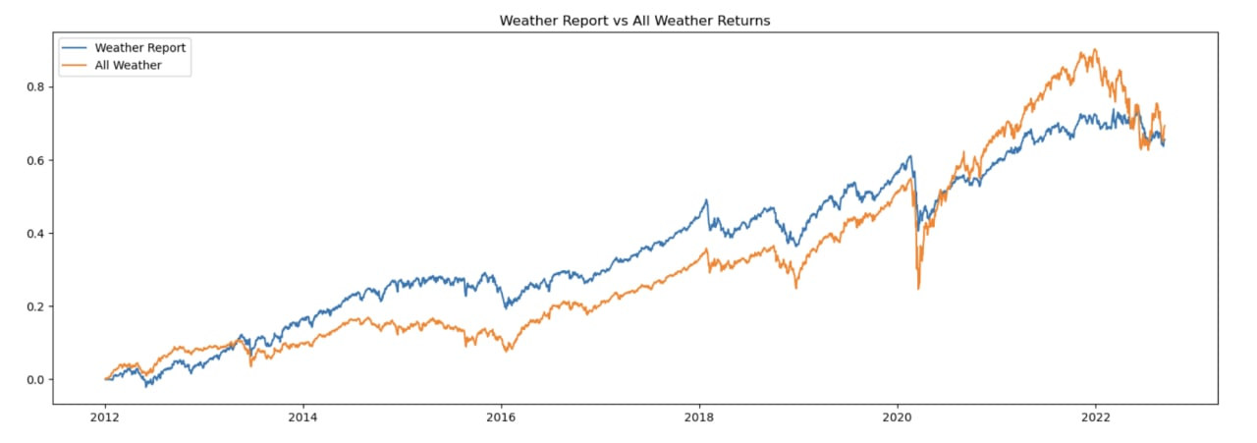
Model: Fed Min
Notes:
Fed minutes

Slide 22
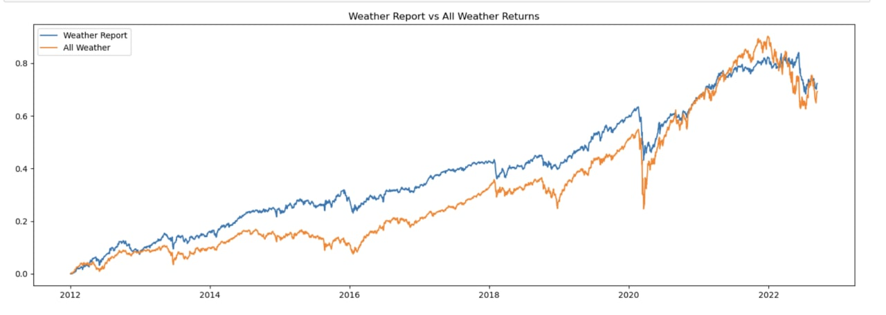
Model:
Fed Speech W2V
Notes:
Fed speech

Slide 23
Strategy Limitations & Future WORK
Assumes no rebalancing for our benchmark (all-weather portfolio)
Simplistic inference from using VIX index as proxy for market expectation
Social Media data to derive market expectation using LDA
Comparison of central bank topic models versus retail topic models
Looking at different central bank’s statements

Slide 24
Sentiment Analysis
By Sam

Slide 25
Data Methodologies

Slide 26
Data Source
Text Data (Fed)
Non-Text Data (ETFs)
Beige Book
Statements
Minutes
Speeches
SPY (Equity)
BND (Bond)
TLT (LT Treasury)
SHY (ST Treasury)
BIL (Cash)
TIP (Inflation Hedge)
GLD (Inflation Hedge)
VNQ (Real Estate)
DBC (Commodity)

Slide 27
Text Data
Beige Book
Economic conditions before meetings
Statements
Policy decision immediately after meetings; 8 times a year
Minutes
Detailed record of meeting 3 weeks after statements
Speeches
By fed officials in between meetings

Slide 28
Non-Text Data
Equity
Bonds
Commodities & Others
SPY: SPDR S&P 500 ETF Trust
BND: Vanguard Total Bond Market ETF
TLT: iShares 20+ Year Treasury Bond ETF
SHY: iShares 1-3 Year Treasury Bond ETF
BIL: SPDR Bloomberg 1-3 Month T-Bill ETF
TIP: iShares TIPS Bond ETF
GLD: SPDR Gold Shares
DBC: Invesco DB Commodity Index Tracking Fund
VNQ: Vanguard Real Estate ETF

Slide 29
Exploratory Data Analysis (EDA)

Slide 30
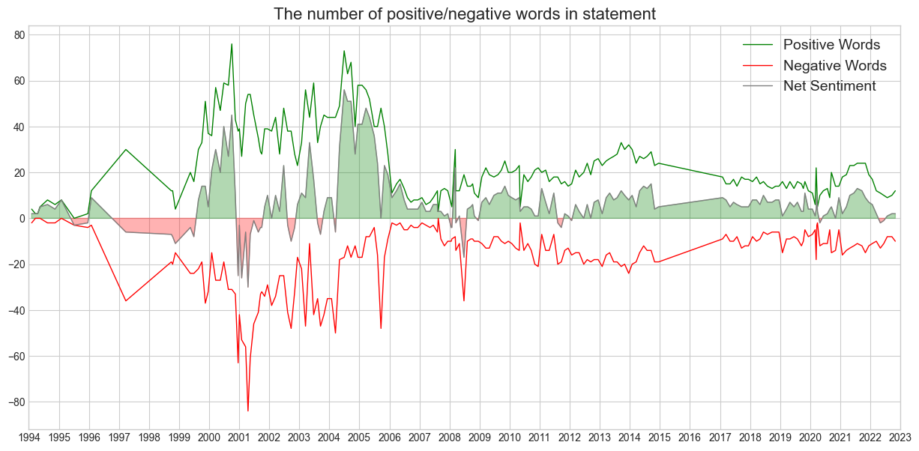

Slide 31
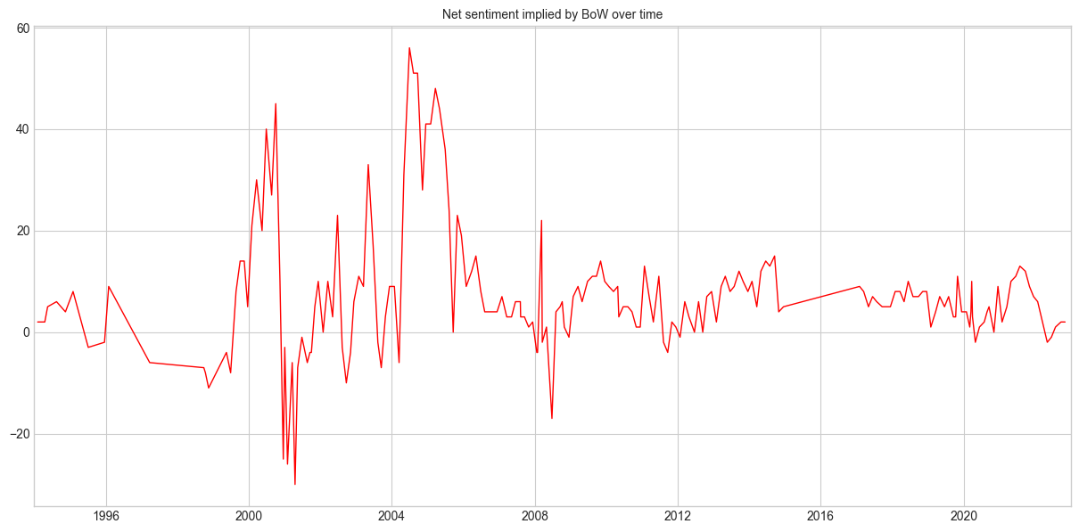
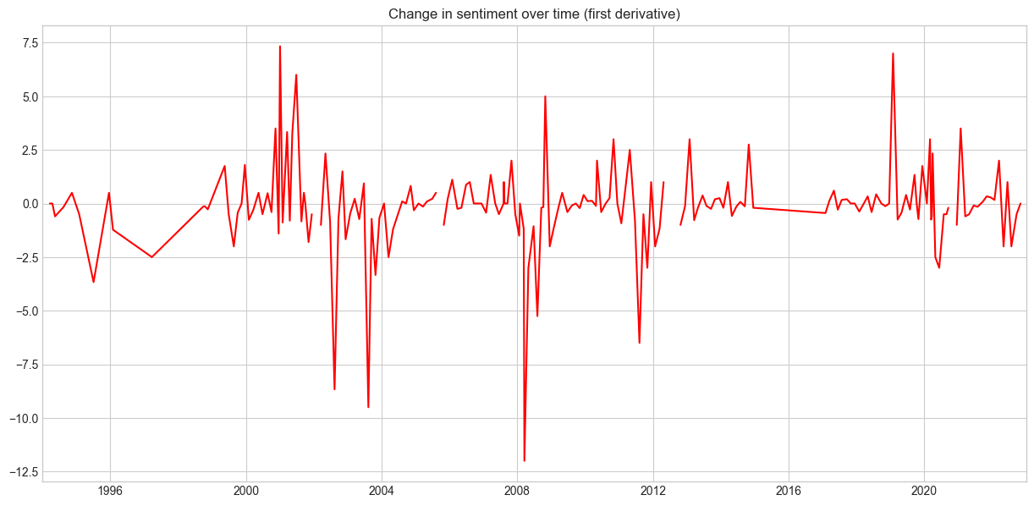

Slide 32
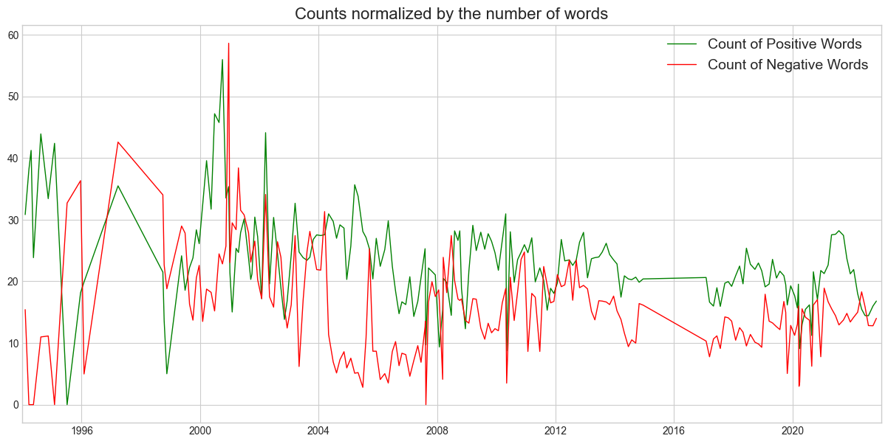

Slide 33
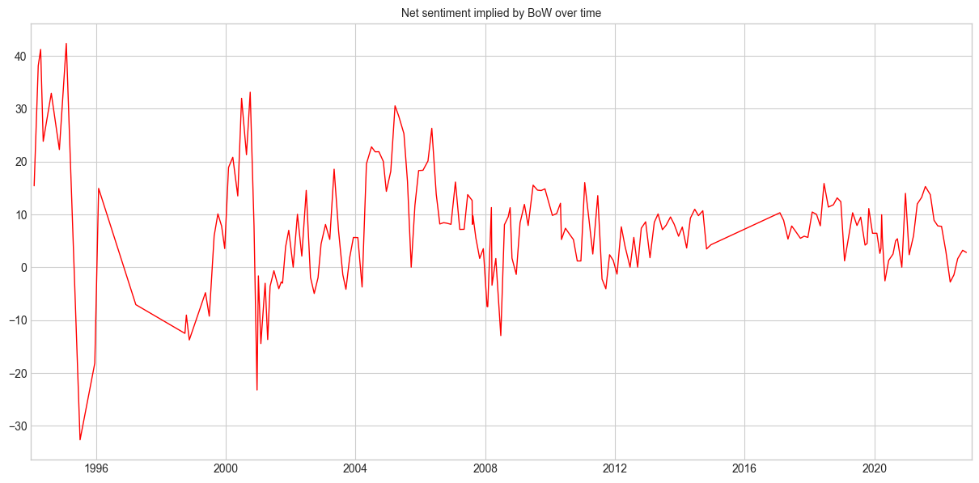

Slide 34
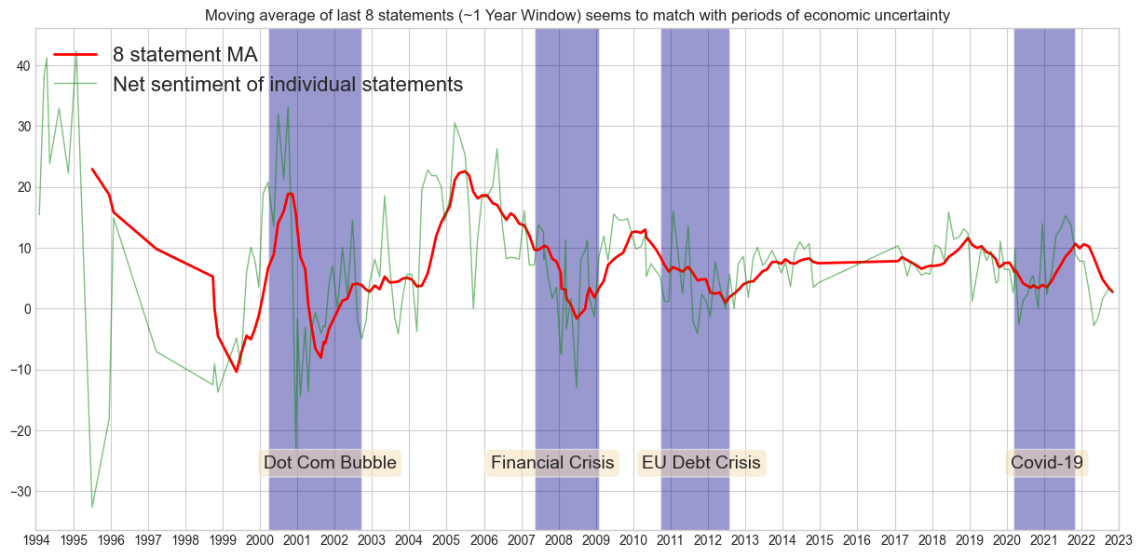

Slide 35
Interpretation of Results

Slide 36
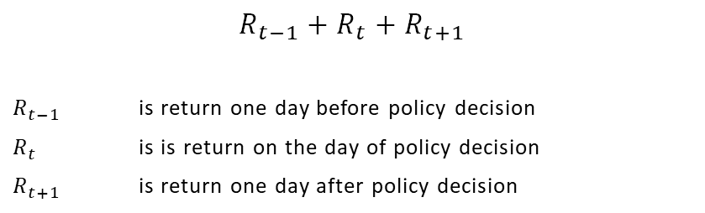
Event Returns
$$R_{t−1}+R_{t}+R_{t+1}$$
$R_{t−1}$ is return one day before policy decision
$R_{t}$ is is return on the day of policy decision
$R_{t+1}$ is return one day after policy decision

Slide 37
TEXTBLOB OVERVIEW
Pre-trained model based on the Naïve-Bayes classification algorithm
Polarity score: convert sentences into a numerical value of sentiment between -1 to +1 (positive-negative)
Subjectivity score: convert sentences into a numerical value of subjectivity between 0 to 1 (objective-subjective)

Slide 38
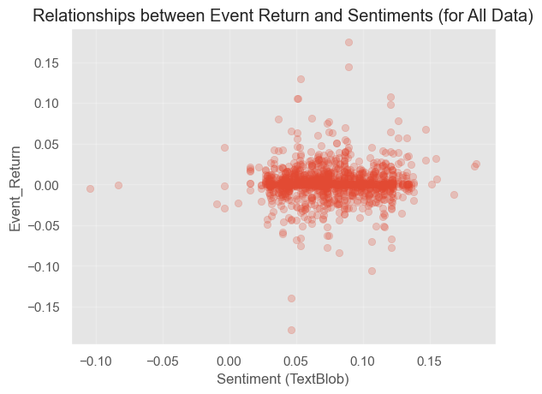
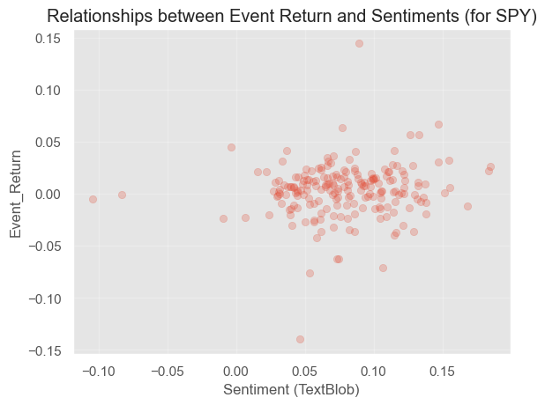
NLP Technique 1: TEXTBLOB

Slide 39
Valence Aware Dictionary for Sentiment Reasoning (VADER) OVERVIEW
Pre-built sentiment analysis model included in the NLTK package
Lexicons are special dictionary or vocabularies created for analyzing sentiments
Trained model based on financial lexicon (~20k words) and applying it to fed statements

Slide 40
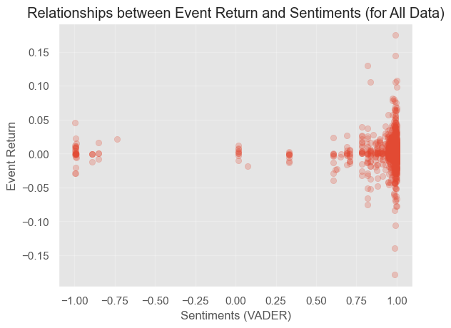
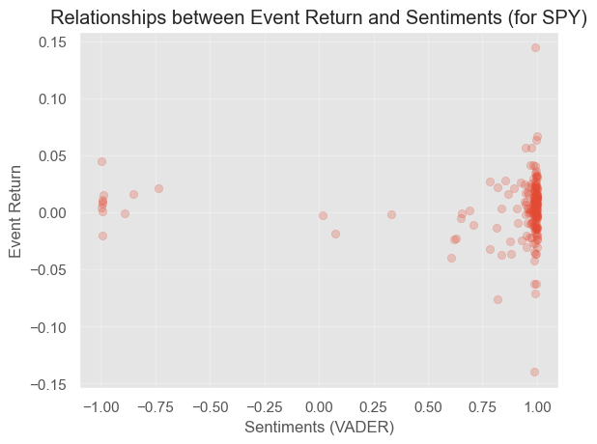
NLP Technique 2: VADER

Slide 41
Loughran-McDonald Sentiment (LMS) OVERVIEW
Gold standard that examines tokens from all 10-K type filings for the full EDGAR 10-K archive and earnings calls from CapIQ
Sentiment categories include negative, positive, uncertainty, litigious, strong modal, weak modal, and constraining
Trained model based on LMS lexicon (~4k words) and applying it to fed statements

Slide 42
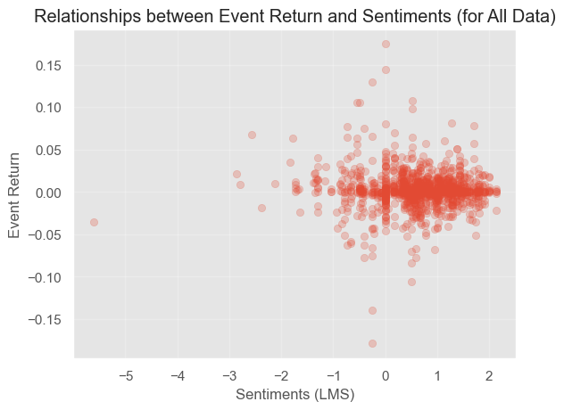
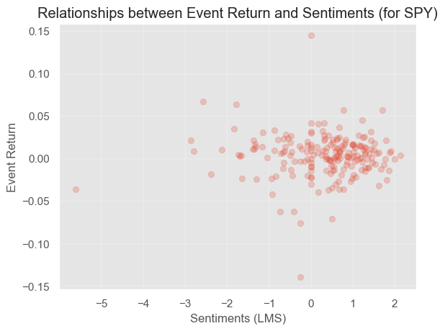
NLP Technique 3: LMS

Slide 43
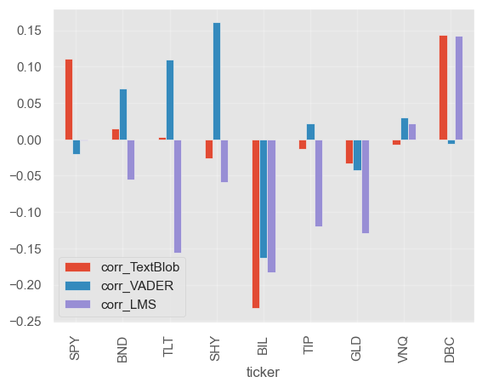
Positive fed = Increasing interest rates
Negative fed = Decreasing interest rates
Increasing interest rates is bad for all asset classes, except commodities and real estate
We shall use the LMS model for our backtesting strategy

Slide 44
Backtesting Strategy

Slide 45
SPY Trading Log (Extract)
SPY
Starting Value of Our Portfolio: 100000.00
1996-01-31, Previous Sentiment -2.38, New Sentiment -0.65 BUY CREATE, 39.53
1996-02-01, BUY DONE, Price: 39.49, Cost: 3948.95, Comm 0.00
1997-03-25, Previous Sentiment -0.65, New Sentiment -2.79 SELL CREATE, 50.06
1997-03-26, SELL DONE, Price: 50.25, Cost: 3948.95, Comm 0.00
1997-03-26, Profit of the operation, GROSS 1076.43, NET 1076.43
…
2021-01-28, SELL DONE, Price: 367.16, Cost: 36130.61, Comm 0.00
2021-01-28, Profit of the operation, GROSS 585.21, NET 585.21
2021-04-28, Previous Sentiment 0.78, New Sentiment 1.57 BUY CREATE, 408.53
2021-04-29, BUY DONE, Price: 411.39, Cost: 41138.64, Comm 0.00
2022-11-29, (MA Period 15) Ending Value 118006.87
Starting Value of Our Portfolio: 100000.00
Final Value of Our Portfolio: 118006.87
Profit: 18006.87

Slide 46
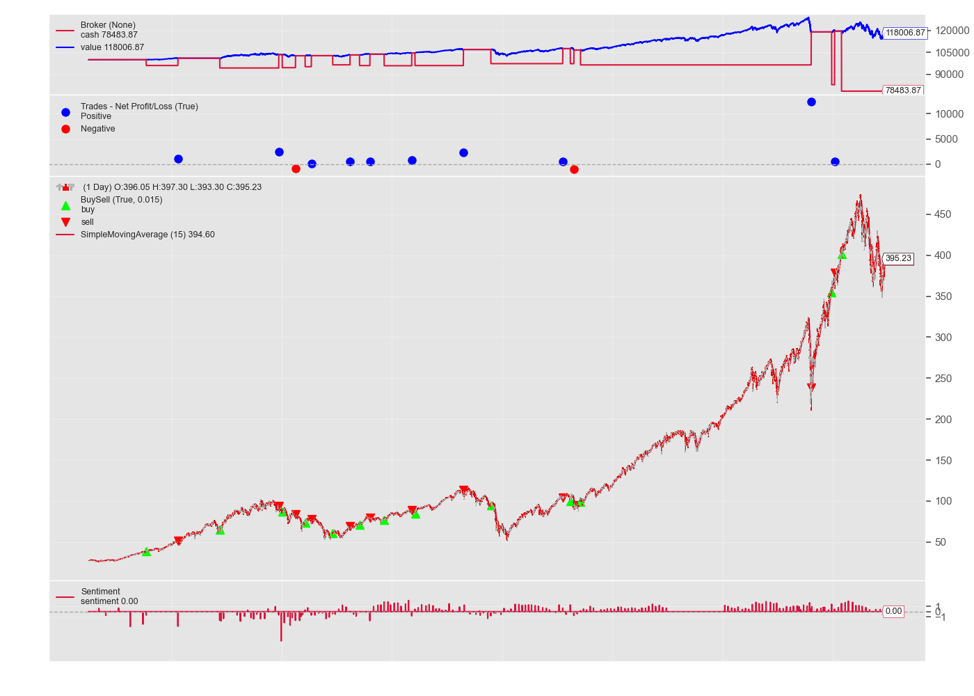
Cash Value Observer
Trade Observer
Buy/Sell Observer
Sentiment Observer

Slide 47
Portfolio of ETFs Trading Results
Performance of Strategy
 | SPY | BND | TLT | SHY | BIL | TIP | GLD | VNQ | DBC
Per Unit Start Price | 27.54 | 46.73 | 41.34 | 58.12 | 82.90 | 55.84 | 44.38 | 22.74 | 22.05
Strategy Profit | 18,006.86 | 199.33 | 2,075.47 | 2,125.70 | 465.73 | 6,372.85 | 14,335.00 | 1,918.22 | 389.39
Sensitivity Analysis (for SPY)
SPY |  | Position size
 |  | 90 | 100 | 110
Change in sentiment | 0.55 | +2.10% | +13.44% | +24.78%
 | 0.5 | -10.00% | $18,007 | +10.00%
 | 0.45 | -31.63% | -24.04% | -16.44%

Slide 48
Limitations & Future WORK
Limitations
Future Work
Lack of training data (8 statements per year)
Data trade-offs (statements are timely but lack context compared to minutes; minutes gives more insights but lagged by 3 weeks giving little applicability)
Data quality (irrelevant and long paragraphs, ML good at learning ~500 words, splitting words by overlapping 200/50 but lose context, etc.)
TFIDF
LSTM/RNN
BERT

Slide 49
Closing Thoughts
By Stanley

Slide 50




